Slide 1
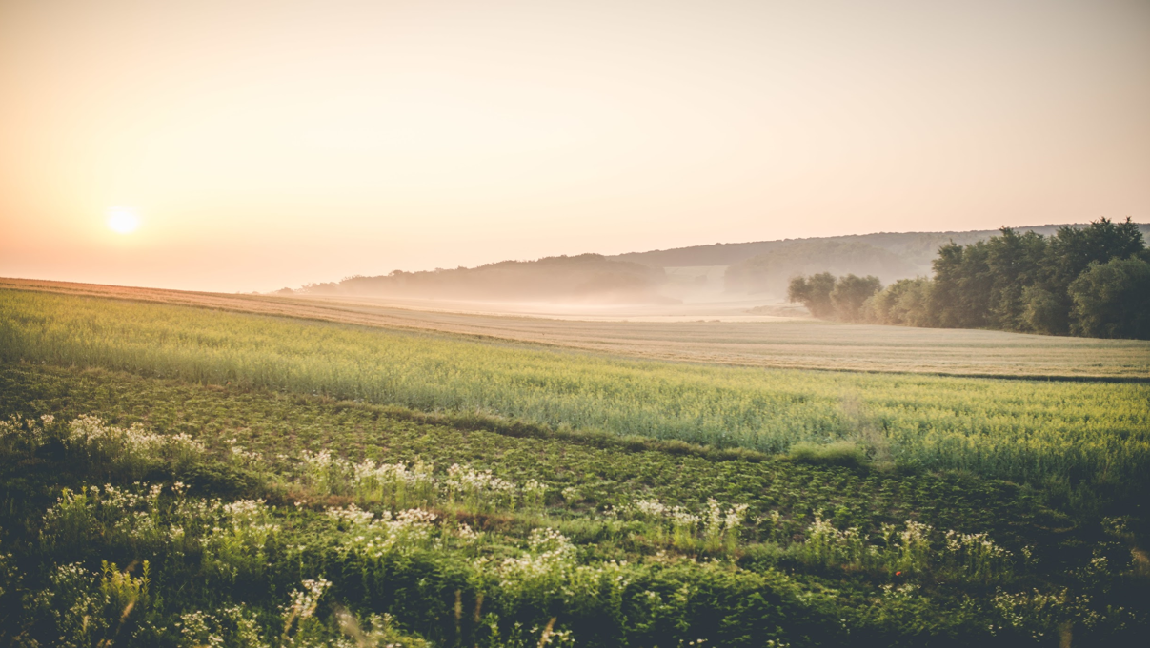

Integrated System for Crop Recommendation, Fertilizers Suggestion and Plant Disease Detection
Project Members: 1. A.Santhosh Kumar –Y20ACS403 2. G.Harshitha -Y20AC445 3. B.Bhavana Sai –Y20ACS419 4. B.Ajay Kumar –Y20ACS414
Project Guide: Mr T.Y.Srinivasa Rao

Slide 2
CONTENTS:
Abstract
Existing System
Existing Methodologies
Design Methodology
Proposed System
Problem Formulation
Objectives
Engineering Knowledge
Literature Review
Hardware Requirements
Software Requirements
Team Work

Slide 3
Abstract:
Precision agriculture is advancing rapidly, integrating machine learning and deep learning techniques to create a comprehensive system for crop recommendation, fertilizer suggestion, and plant disease detection. This system aims to optimize crop selection, recommend suitable fertilizers, and identify potential crop diseases by leveraging data on crop attributes, soil characteristics, and environmental factors such as soil type, climate, rainfall, humidity, and temperature, as well as parameters like nitrogen, phosphorus, and potassium content in the soil. The ultimate goal is to enhance agricultural productivity and minimize crop losses through tailored solutions.

Slide 4
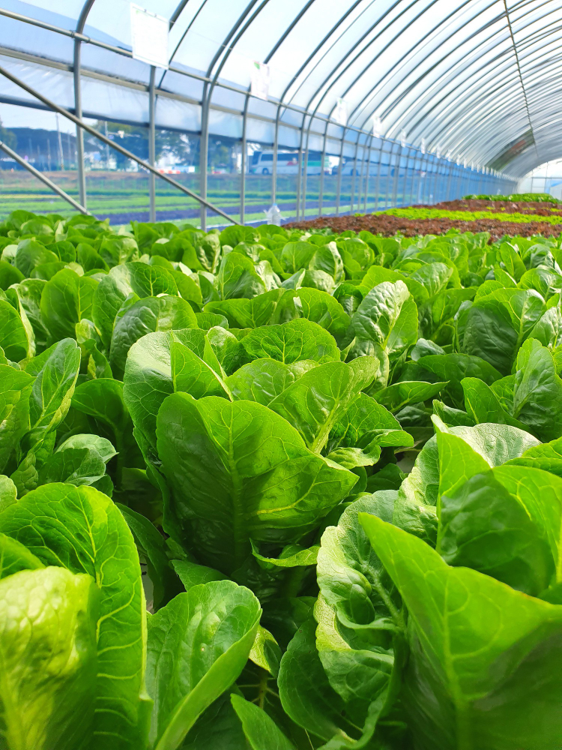
Existing System
Plantix
Plantix is a mobile application that offers plant disease detection and pest recognition services. It uses image recognition technology.
AgroCares Scanner
AgroCares Scanner is a handheld device that measures nutrient levels in soil samples and provides instant analysis through a mobile application.
Green IQ
An AI-powered platform that offers personalized recommendations for plant care, including watering schedules, fertilizer application, and pest management strategies.

Slide 5

Existing Methodologies
The methodologies used in Plantix, AgroCare Scanner
and Green IQ
Random Forest
Support Vector Machines (SVMs)
Decision Trees
Limitations
Limited coverage of plant disease.
These systems do not incorporate all functions within a single system.

Slide 6
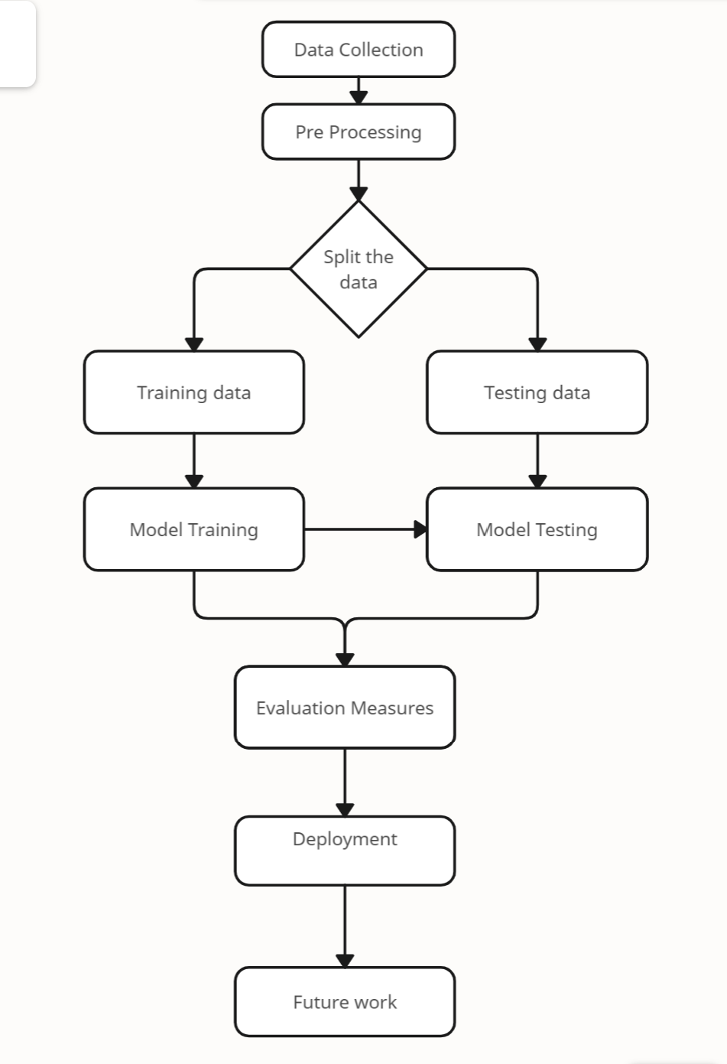
Design Methodology

Slide 7
Contd..
Dataset Collection
Collected the dataset from Kaggle.
Data Pre-processing
Checking for null values in the dataset and handle them appropriately and preparing the data for training and testing.
Feature Extraction
Identifying key characteristics that influence crop yield and suitability.
Input features are: Nitrogen, Phosphorus, Potassium, temperature, humidity, ph, rainfall.
Algorithms Applied
Algorithms
Decision Tree
Decision Tree is a tree-structured classifier, where internal nodes represent the features of a dataset, branches represent the decision rules and each leaf node represents the outcome.
Naive Bayes
Naive Bayes is a probabilistic classifier it predicts on the basis of the probability of an object.

Slide 8
Contd..
Support Vector Machine
The SVM algorithm is to create the best line or decision boundary that can segregate n-dimensional space into classes so that we can easily put the new data point in the correct category in the future. This best decision boundary is called a hyperplane.
Logistic Regression
Logistic Regression is a supervised machine learning model which is used for solving the classification problems. It is used for predicting the categorical dependent variable using a given set of independent variables.
Random Forest
Random Forest is a classifier that contains a number of decision trees on various subsets of the given dataset and takes the average to improve the predictive accuracy of that dataset.
Extreme Gradient Boosting (xgboost)
Extreme Gradient Boosting is a gradient boosting algorithm for supervised learning. It's a highly efficient and scalable implementation of the boosting algorithm, with performance comparable to that of other state-of-the-art machine learning algorithms in most cases.

Slide 9

Proposed System
Our proposed system uses computer techniques to assist farmers in managing their crops better. It provides guidance on which crops to grow, which fertilizers to use, and how to identify plant diseases. This platform helps farmers make smarter decisions and enhance their farming methods. By analyzing large amounts of data, it can offer accurate suggestions for crop management, fertilizer suggestion, and disease detection.

Slide 10
Problem Formulation
Problem Statement: In modern agriculture, farmers face numerous challenges related to crop selection, optimal nutrient management, and early detection of plant diseases. The integrated system aims to seamlessly combine crop recommendation, fertilizer suggestions, and plant disease detection capabilities into a single platform.
Scope
Integrated system for crop recommendation, fertilizer suggestion, and plant disease detection using machine learning and deep learning would primarily focus on its application within agricultural settings, including farms, plantations, and agricultural research institutions. This system aims to assist farmers and agricultural experts in making informed decisions regarding crop cultivation, soil management, and disease prevention to enhance productivity, Additionally, it may find utility in agricultural advisory services, educational institutions, and governmental agencies involved in agricultural development and support.

Slide 11
Objectives
Maximizing Yield: Recommending crops that are well-suited to the climate conditions, soil type, and environmental factors can help maximize yield potential.
Diversification: Recommending a diverse range of crops can help minimize risks associated with pests, diseases, and market fluctuations.
Nutrient Optimization: Recommending the appropriate type and quantity of fertilizers based on soil nutrient levels and crop requirements can optimize nutrient uptake and minimize waste.
Early Detection: Catch plant diseases early, allowing farmers to act quickly and save their crops from damage, ensuring better harvests and higher yields.

Slide 12
Work Planning
Week | Work Done
Week1 | Explored on various problems in present days and project selection
Week2 | Gone through various research papers
Week3 | Study of previous models and their disadvantages
Week4 | Dataset collection
Week5 | Developing code
Week6
Week7 | Developing code and debugging errors
Week8 | Enhancement of code
Week9 | Real world deployment
Week10 | Documentation

Slide 13
Week1
1. Driver Drowsiness Detection System
2. Detection of Fake Online Reviews
3. Detection of Fraud Apps
In week 1 of our project, we focused on researching various project ideas. We explored different topics and gathered information about each idea. This involved searching online, reading articles, and discussing ideas with team members.
We aimed to find projects that align with our interests, skills, and project goals. We looked for projects that are feasible to implement within our timeframe and resources. Additionally, we considered the potential impact and novelty of each idea.

Slide 14
Week2
Websites -
1. IEEE( Institute of Electrical and Electronics Engineer).
2. Scientific Research Publishing
During the second week of our project, we did more research by reading papers and articles from places like IEEE to learn more about our project topic.
We conducted searches using keywords and phrases related to our project to find relevant literature. We carefully reviewed the abstracts, keywords, and summaries of the papers to identify those that aligned closely with our project goals and objectives. We also looked for insights, methodologies, and findings that could inform and enhance our own project.

Slide 15
Week3
Previous Models:
1. Plantix
2. AgroCares Scanner
3. Green IQ
Disadvantages:
Limited coverage of plant disease.
These systems do not incorporate all functions within a single system.
Results are not more accurate.

Slide 16
Week4
Dataset Collection
Crop recommendation.csv
Nitrogen - ratio of Nitrogen content in soil
Phosphorus - ratio of Phosphorous content in soil
Potassium - ratio of Potassium content in soil
Temperature - temperature in degree Celsius
Humidity - relative humidity in %
ph - ph value of the soil
Rainfall - rainfall in mm
Label – Display the predicted crop labels

Slide 17
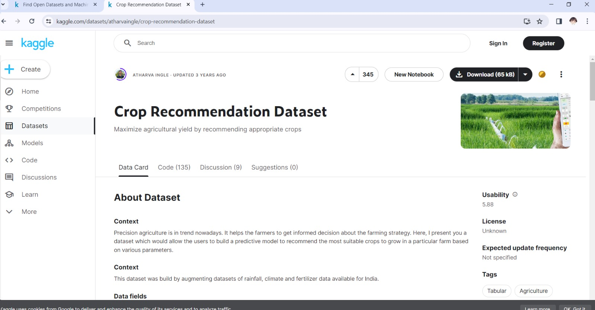
Week5
Some screenshots of Datasets

Slide 18
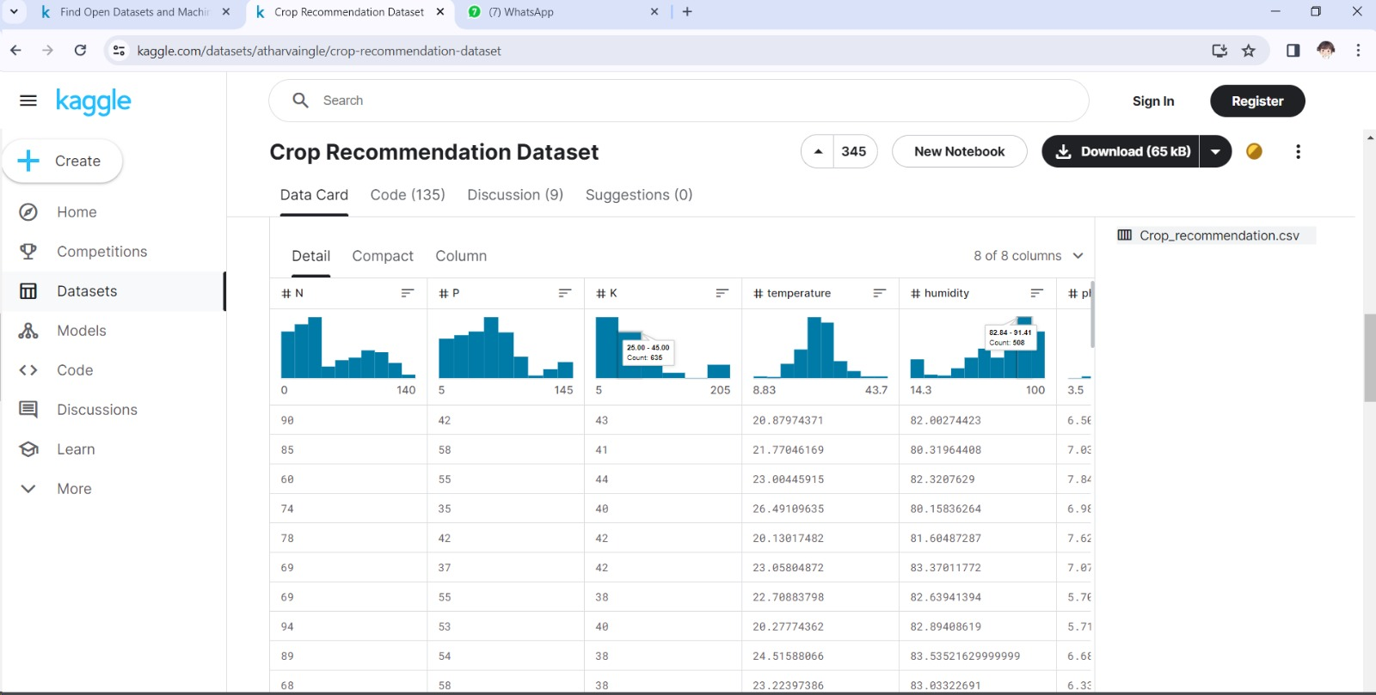

Slide 19
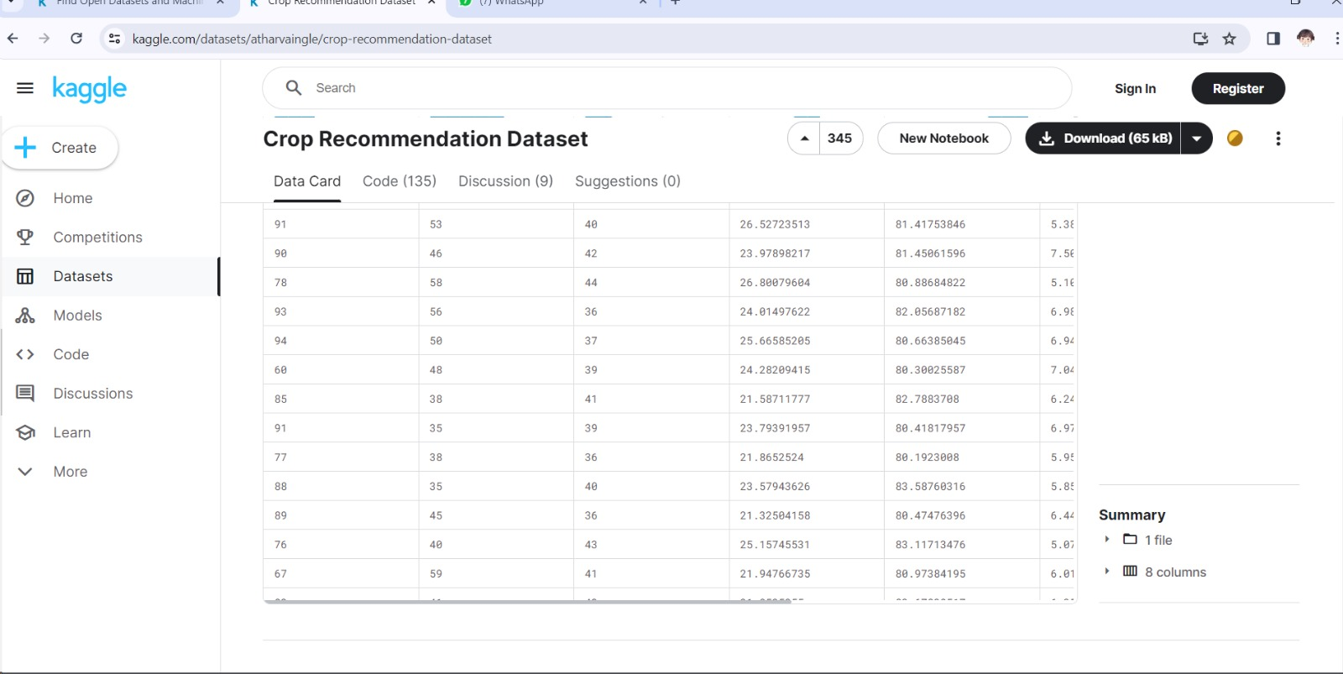

Slide 20
Step | Description
Loading and splitting the dataset | Here we are Loading the data from the dataset into a .csv file and splitting the data. Packages used: Pandas, Numpy, Scikit-learn, Matplotlib Methods used: read_csv, train_test_split Input: https://www.kaggle.com/datasets/atharvaingle/crop-recommendation dataset Output: Data splitted (Training data, Testing data)
Step | Description
Training the Model | Here we are creating and Training the Model. Source Code: Jupyter notebook Model used: Decision Tree, Naive Bayes, Support Vector Machine, Logistic Regression, Random Forest, Extreme Gradient Boosting (xgboost). Input : Text data Output: Text data.

Slide 21
Engineering Knowledge
Data Acquisition and Management:
. Soil data collection
. Weather data integration
. Image acquisition for disease detection
Machine Learning and Deep Learning Techniques:
. Crop recommendation: Classification algorithms
. Fertilizer recommendation
. Plant disease detection

Slide 22
Literature Review
 | Prashant kumar Keshav bhagat Kusam lata Sushant jhingram | International Conference on Disruptive Technologies (ICDT) 2023 | Naive bayes, Decision tree, Random forest, KNN, Support Vector Machine
Plant Disease Detection Using Deep Learning | Murk Chohan Adil Khan Rozina Chohan Saif Hassan Katpar Muhammad Saleem Mahar | 2020 International Journal of Recent Technology and Engineering (IJRTE) 2020 | Convolutional Neural Networks (CNN)
Journal Name Publication Year
Title
Author
Algorithms
Crop Recommendation using Machine Learning Algorithms

Slide 23
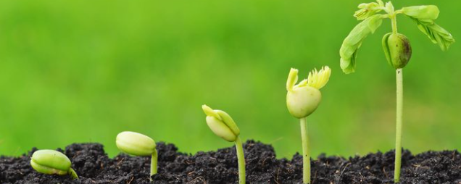
Hardware Requirements
Operating System-Windows Family
Processor-Intel Core i3
Storage:256 GB
RAM:8 GB
Internet Connection-10-25 Mbps
Software Requirements
Programming Languages:
Python
Packages:
Pandas: This library is used for data manipulation and analysis.
Numpy: Required for numerical computing.
Scikit-learn: This library provides various tools for machine learning tasks.
Matplotlib: Used for data visualization.
WorkSpace:
Jupyter Notebook

Slide 24
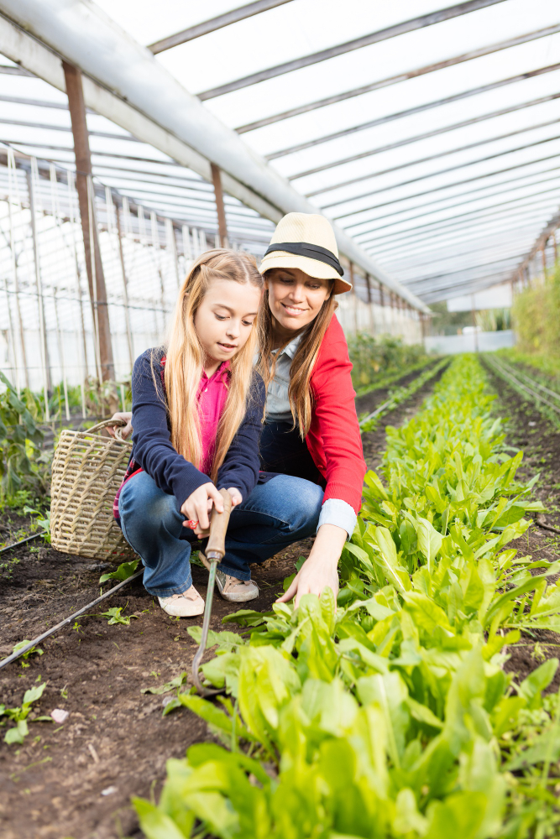
Team Work
B.Ajay Kumar - Y20ACS414
Data Collection and Preprocessing
B.Bhavana Sai – Y20ACS419
Data Analysis
A.Santhosh Kumar – Y20ACS403
Model Construction and Fitting
G.Harshitha – Y20ACS445
Evaluation, Validation, and Comparison

Slide 25
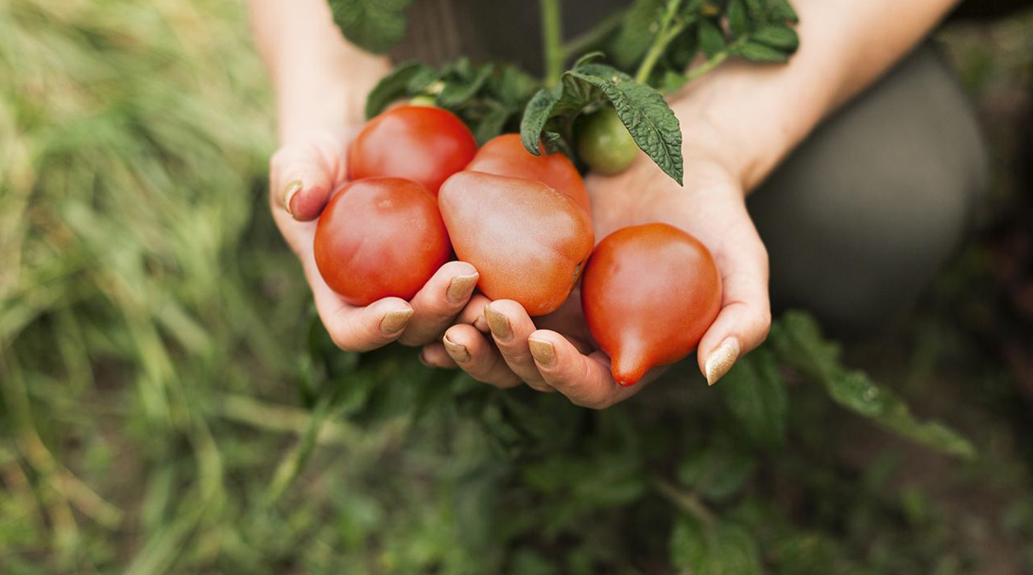
Thank You

